Slide 1


SMART INDIA HACKATHON 2026
TITLE PAGE
  Problem Statement ID – 26056
  Problem Statement Title- Real-Time Airfare Price
Index for India using
Automated Web Scraping
to Augment CPI.
  Theme- Smart Automation
  PS Category- Software
  Team ID- 131
  Team Name - kaasukabe

Slide 2


kasukaabe
2. PROPOSED SOLUTION
AIRINDEX(APIx) — Intelligent. Timely. Transparent.
OUR PROPOSAL
EXISTING CPI SYSTEM
Airfare under Transport & Communication
consumer
price basket
weighted CPI calculation
monthly CPI
inflation and policy analysis
APIx proposes
higher-frequency
airfare insight
  Multisource webscraping engine
  Scheduled daily extraction
  Collects fare observations across 20 representative routes and T+1, T+7, T+15, T+30 and T+45 windows.
  Turning flight prices into economic signal.
HOW IT WORKS
DATA CLEANING
Daily
APIx
Data
sources
automated
scraping
DATA CLEANING
ROUTE
WEIGHTING
Historical and calendar context
Data
sources
ROUTE
WEIGHTING
Data
sources
Actual vs expected
Daily
APIx
Expected normal fare
Daily APIx
Dashboard +
API
Dashboard +
API
WHY IT IS UNIQUE
  HIGH-FREQUENCY AIFARE MONITORING
  ROUTE LEVEL + OVERALL APIX
  PURPOSE-BUILT AUTOMATED COLLECTION ENGINE
  Our system is compatible to work with diferent APIs
  Our system is compatibe to work with seasonal, holiday and other factors.
2
Notes:
2

Slide 3
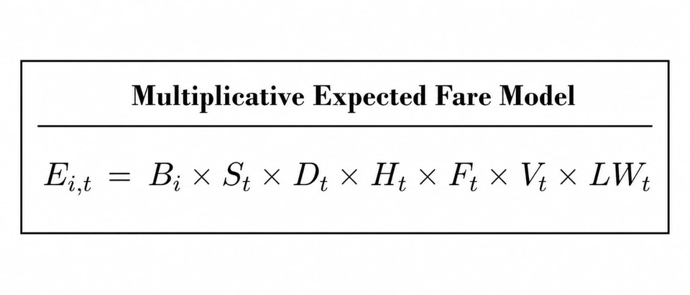
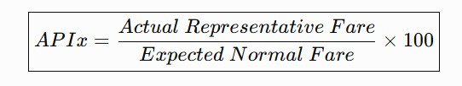
kasukaabe
3. TECHNICAL APPROACH
Tech Stack :-
Methodology / Workflow :-
Fare Collection
(Airlines / OTAs)
Forecasting
Model
  Frontend
  Data Cleaning
National
APIx
React.js, HTML, CSS, JavaScript
Python, Pandas
  Backend & API
  Index Engine
Python – Weighted APIx Calculation
Raw Fare
Observations
Tomorrow's
APIx
Python, FastAPI, REST API
  Automation
Route-Level
APIx
  Web Scraping
Scheduler + Automated Collection Pipeline
Python, Playwright
  Security
Data Cleaning
& Validation
  Database
Authentication, Rate Limiting, Input Validation, Secure Env Config
Dashboard
Output
PostgreSQL
APIx (t)
Calculation
Clean Fare
Data
APIx = (Actual Representative Fare / Expected Normal Fare) × 100
Representative
Base Fare
Historical Context
(Seasonality, DOW,
Holidays)
Expected
Normal Fare

Slide 4
kasukaabe
4. FEASIBILITY AND VIABILITY
Feasibility
Challenges
Strategies
  We use Kagalle dataset to genarete a more impactful dataset.
  Scalability — start small, then scale routes
  Automated Collection
  Structured data pipeline
  Real time fare monitoring enables timely booking insights
  Changes in fares – demand , cancellations , routes , festival and booking time.
  Data inconsistency – different platform show different fares
  Anti-scraping defenses (CAPTCHAs, IP blocks, dynamic pages)
  Frequent scraping risks rate-limits or bans
  Limited historical data for new routes
  Distributed data sources to ensure continuous availability
  Outlier detection & smoothing before indexing
  We collect our data on daily basis to create our own dataset.
  Collection at different times of a day
  Multi source validation - compare fares across platforms

Slide 5
5. IMPACT & BENEFITS
kasukaabe
Your Team Name
SIH
WHO BENEFITS?
Government & Statistical Agencies, Economists & Researchers, Transport Analysts, Travelers.
  BETTER INFLATION MEASUREMENT:
  Higher frequency view of airfare measures.
  Compliments existing CPI airfare data.
  SMARTER POLICY DECISIONS:
  Identifies which routes are driving airfare changes with the help of the DGCA and the dataset.
  Supports better statistical and economic analysis
3.GRANULAR AIRFARE INTELLIGENCE:
  Compares fares across routes, airlines and booking windows.
  Shows how fares change as travel approaches.
4. Reliable & Transparent Data:
  Detects duplicates, missing values and unusual observations.
  Provides data-quality and coverage indicators.
5.ECONOMIC & SOCIAL VALUE:
  Helps economists and researchers understand airfare movements.
  Supports transport and inflation-related analysis.
6. SCALABLE DIGITAL INFRASTRUCTURE
  Allows more routes and permitted data sources to be added.
  Provides an API for use by downstream statistical systems.
Notes:
6

Slide 6







kasukaabe
6. RESEARCH AND REFERENCES
MoSPI
(Ministry of Statistics and Programme Implementation)
Expert Group Report on Comprehensive Updation of CPI (2026)
mospi.gov.in
B. TECHNICAL REFERENCES (TOOLS & TECHNOLOGIES)
React
Playwright Python
A. GOVERNMENT & STATISTICAL SOURCES
Interactive dashboard
Automated web data collection
(Ministry of Civil Aviation / Press Information Bureau)
MoCA / PIB
FastAPI
PostgreSQL
Tariff Monitoring Unit — Airfare Monitoring (2023)
pib.gov.in
REST API & validation
Structured data storage
Pandas
Python
DGCA / Sansad
(Directorate General of Civil Aviation )
Data cleaning & transformation
Automation & data processing
Tariff Monitoring Unit — 78 selected routes (2026)
sansad.in
Ultimate Web Scraping Tutorial (Code With Harry)
https://www.youtube.com/watch?v=1227R6KY8Ts
We have used Evidence-based methodology • Government sources • Open technical documentation
SMART INDIA HACKATHON 2026 • AIRINDEX
6

